Slide 1
CS 575
Design and Analysis of
Computer Algorithms
Professor Michal Cutler
Greedy method, activity selection

Slide 2
This class
Greedy method
Activity selection
Greedy versus dynamic programming

Slide 3
The Greedy Method
Greedy algorithms make good local choices in the hope that they result in an optimal solution.
  They result in feasible solutions.
  Not necessarily optimal ones.
A proof is needed to show that the algorithm finds an optimal solution.
A counter example shows that the greedy algorithm does not provide an optimal solution.

Slide 4
Pseudo-code for Greedy Algorithm
set Greedy (Set Candidate){
solution= new Set( );
while (Candidate.isNotEmpty()) {
next = Candidate.select(); //use selection criteria,
//remove from Candidate and return value
if (solution.isFeasible( next)) //constraints satisfied
solution.union( next);
if (solution.solves()) return solution}
//No more candidates and no solution
return null
}

Slide 5
Pseudo code for greedy cont.
select() chooses a candidate based on a local selection criteria, removes it from Candidate, and returns its value.
isFeasible() checks whether adding the selected value to the current solution can result in a feasible solution (no constraints are violated).
solves() checks whether the problem is solved.

Slide 6
Elements of the Greedy Strategy
Cast problem as one in which we make a greedy choice and are left with one subproblem to solve.
To show optimality:
Prove there is always an optimal solution to original problem that makes the greedy choice.

Slide 7
Elements of the Greedy Strategy
2. Demonstrate that what remains is a subproblem with property:
If we combine the optimal solution of the subproblem with the greedy choice we have an optimal solution to original problem.

Slide 8
Activity Selection
Given a set S of n activities with start time s_{i} and finish time f_{i} of activity i
Find a maximum size subset A of compatible activities (maximum number of activities).
Activities are compatible if they do not overlap
Can you suggest a greedy choice?

Slide 9
Example
Activities
1
2
3
4
5
6
7
11 13
2 12
3 10
11 15
3 7
1 4
0 2
Time
0 1 2 3 4 5 6 7 8 9 10 11 12 13 14 15

Slide 10
Counter Example 1
Select by start time
Activities
1
2
3
11 15
1 4
0 15
Time
0 1 2 3 4 5 6 7 8 9 10 11 12 13 14 15

Slide 11
Counter Example 2
Select by minimum duration
Activities
1
2
3
8 15
1 8
7 9
Time
0 1 2 3 4 5 6 7 8 9 10 11 12 13 14 15

Slide 12
Counter Example 3
Compute for each activity its maximum number of conflicts at any given time.
Select next activity by minimum number of conflicts
X
1 3
5 7
9 11
12 14
Time
0 1 2 3 4 5 6 7 8 9 10 11 12 13 14 15
Activity X has the minimum number of conflicts. Solution with 3 instead of 4

Slide 13
Select by finishing time
Activities
1
2
3
4
5
6
7
11 13
2 12
3 10
11 15
3 7
1 4
0 2
Time
0 1 2 3 4 5 6 7 8 9 10 11 12 13 14 15

Slide 14
Activity Selection
Assume without loss of generality that we number the intervals in order of finish time. So f₁≤...≤f_{n}.
Greedy choice: choose activity with minimum finish time
The following greedy algorithm starts with A={1} and then adds all compatible jobs. (Theta(n))
Theta(nlogn) when including sort

Slide 15
Greedy-Activity-Selector(s,f)
n <- length[s] // number of activities
A <- {1}
j <- 1 //last activity added
for i <- 2 to n //select
if s_{i} >= f_{j} then //compatible (feasible)
add {i} to A
j <- i //save new last activity
return A

Slide 16
Proof that greedy solution is optimal
It is easy to see that there is an optimal solution to the problem that makes the greedy choice.
Proof of 1.
Let A be an optimal solution. Let activity 1 be the greedy choice. If 1 ∈ A the proof is done. If 1 ∉A, we will show that A’=A-{a}+{1} is another optimal solution that includes 1.
Let a be the activity with minimum finish time in A.
Since activities are sorted by finishing time in the algorithm, f(1) ≤ f(a). If f(1) ≤ s(a) we could add 1 to A and it could not be optimal. So s(1) < f(a), and 1 and a overlap. Since f(1) ≤ f(a), if we remove a and add 1 we get another compatible solution A’=A-{a}+{1} and |A’|=|A|

Slide 17
Proof that greedy solution is optimal
2. If we combine the optimal solution of the remaining subproblem with the greedy choice we have an optimal solution to the original problem.
Proof of 2.
Let activity 1 be the greedy choice.
Let S’ be the subset of activities that do not overlap with 1.
S’={i|i =1,…,n and s_{i}≥ f(1)}.
Let B be an optimal solution for S’.
From the definition of S’, A’={1}+B is compatible, and a solution to the original problem.

Slide 18
Proof that greedy solution is optimal
2. If we combine the optimal solution of the remaining subproblem with the greedy choice we have an optimal solution to the original problem.
Proof of 2 continued.
The proof is by contradiction.
Assume that A’ is not an optimal solution to the original problem.
Let A be an optimal solution that contains 1.
So |A|>|A’|, and |A-{1}|>|A’-{1}|=|B|.
But A-{1} is also a solution to the problem of S’, contradicting the assumption that B is an optimal solution to S’.

Slide 19
Greedy Approach VS Dynamic Programming (DP)
Greedy and Dynamic Programming are methods for solving optimization problems.
Greedy algorithms are usually more efficient than DP solutions.
However, often you need to use dynamic programming since the optimal solution cannot be guaranteed by a greedy algorithm.

Slide 20
The 0/1 Knapsack problem
Given a knapsack with weight W > 0.
A set S of n items with weights w_{i} >0 and
benefits b_{i}> 0 for i = 1,…,n.
S = { (item₁, w₁, b₁ ), (item₂, w₂, b₂ ) ,
. . . , ( item_{n,} w_{n}, b_{n} ) }
Find a subset of the items which does not exceed the weight W of the knapsack and maximizes the benefit.

Slide 21
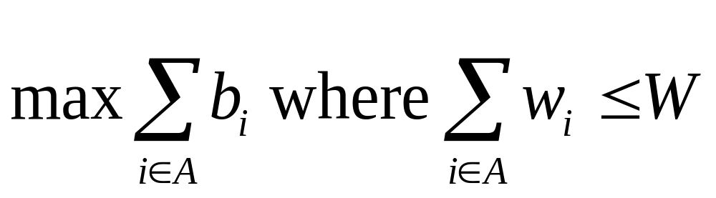
0/1 Knapsack problem
Determine a subset A of { 1, 2, …, n } that satisfies the following:
In 0/1 knapsack a specific item is either selected or not

Slide 22
Variations of the Knapsack problem
Fractions are allowed. This applies to items such as:
  bread, for which taking half a loaf makes sense
  gold dust
Integer values (no fractions).
  0/1 (1 brown pants, 1 green shirt…)
  0/any Allows putting many items of same type in knapsack
    5 pairs of socks
    10 gold bricks
  More than one knapsack, etc.
First 0/1 integer knapsack problem will be covered then the 0/1 fraction knapsack problem.

Slide 23
0/1 integer knapsack
Brute force!
Generate all 2^{n} subsets
Discard all subsets whose sum of the weights exceed W (not feasible)
Select the maximum total benefit of the remaining (feasible) subsets
What is the run time?
O(n 2^{n}), Omega(2^{n})
Lets try the greedy strategy .

Slide 24
Example with “brute force”
S = { ( item₁ , 5, $70 ), (item₂ ,10, $90 ), ( item₃, 25, $140 ) } , W=25
Subsets:
1. {}
2. { ( item₁ , 5, $70 ) } Profit=$70
3. { (item₂ ,10, $90 ) } Profit=$90
4. { ( item₃, 25, $140 ) } Profit=$140
5. { ( item₁ , 5, $70 ), (item₂ ,10, $90 )}. Profit=$160 ****
6. { (item₂ ,10, $90 ), ( item₃, 25, $140 ) } exceeds W
7. { ( item₁ , 5, $70 ), ( item₃, 25, $140 ) } exceeds W
8. { ( item₁ , 5, $70 ), (item₂ ,10, $90 ), ( item₃, 25, $140 ) } exceeds W

Slide 25
Greedy 1: Selection criteria: Maximum beneficial item.
Counter Example:
S = { ( item₁ , 5, $70 ), (item₂ ,10, $90 ), ( item₃, 25, $140 ) }
$140
10 lb
W = 25lb
$90
$140
$70
5 lb
25 lb
$70
25 lb
10 lb
$90
5 lb
10 lb
item₁
item₂
item₃
Knapsack
Greedy
Solution
=$140
Optimal
Solution
=$160

Slide 26
Greedy 2: Selection criteria: Minimum weight item
Counter Example:
S = { ( item₁ , 5, $150 ), (item₂ ,10, $60 ), ( item₃, 20, $140 ) }
5 lb
$140
W =
30lb
$140
20 lb
$60
$60
20 lb
10 lb
$150
10 lb
$150
5 lb
$150
5 lb
5 lb
item₁
item₂
item₃
Knapsack
Greedy
Solution
=$210
Optimal
Solution
=$290

Slide 27
Greedy 3: Selection criteria: Maximum weight item
Counter Example:
S = { ( item₁ , 5, $150 ), (item₂ ,10, $60 ), ( item₃, 20, $140 ) }
5 lb
10 lb
$60
$140
W =
30lb
$140
20 lb
$60
20 lb
$150
10 lb
20 lb
$140
$150
5 lb
5 lb
item₁
item₂
item₃
Knapsack
Greedy
Solution
Optimal
Solution
=$200
=$290

Slide 28
Greedy 4: Selection criteria: Maximum benefit per unit item Counter Example
S = { ( item₁ , 5, $50 ), ( item₂, 20, $140 ) (item₃ ,10, $60 ), }
5 lb
B/W: $7
$140
W =
30lb
$140
20 lb
$140
B/W 2: $6
20 lb
B/W 1: $10
$60
20 lb
$50
10 lb
$60
10 lb
$50
5 lb
5 lb
item₁
item₂
item₃
Knapsack
Greedy
Solution
=$190
Optimal
Solution
=$200
What is the asymptotic runtime of this algorithm?

Slide 29
An Optimal Greedy Algorithm for Knapsack with Fractions (KWF)
The following algorithm provides the optimal benefit:
The greedy algorithm uses the maximum benefit per unit selection criteria
  1. Sort items in decreasing b_{i} / w_{i}.
  2. Add items to knapsack (starting at the first) until there are no more items, or the next item to be added exceeds W.
  3. If knapsack is not yet full, fill knapsack with a fraction of next unselected item.

Slide 30
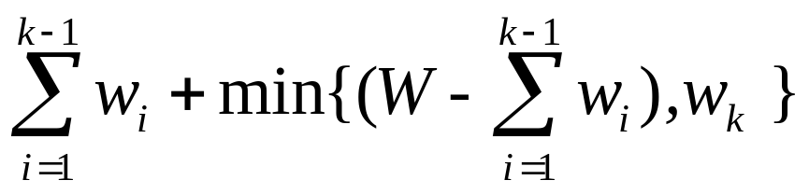
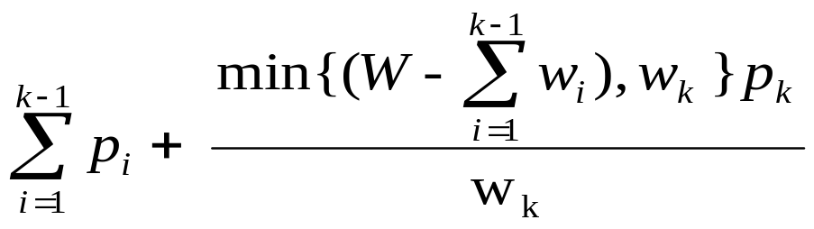
KWF
Let k be the index of the last item included in the knapsack. We may be able to include the whole or only a fraction of item k
totweight =
profitKWF =
min{(W – sum of first k-1),w_{k} }/w_{k}, means that we either take the whole of item k when the knapsack can include the item without violating the constraint, or we fill the knapsack by a fraction of item k

Slide 31
Example of applying the optimal greedy algorithm for Fractional Knapsack Problem
S = { ( item₁ , 5, $50 ), ( item₂, 20, $140 ) (item₃ ,10, $60 ), }
B/W: $7
5 lb
5/10 * $60 = $30
$140
30lb
Max
Optimal
benefit $220
Solution:
items 1and 2
and 1/2 of
item 3
$140
B/W 2: $6
20 lb
B/W 1: $10
$60
20 lb
$50
10 lb
$50
5 lb
5 lb
item₁
item₂
item₃
Knapsack
Greedy
Solution
=
Optimal
Solution

Slide 32
Principle of Optimality for 0/1 Knapsack problem
Theorem: 0/1 knapsack satisfies the principle of optimality
Proof: Assume that item_{i} is in the most beneficial subset that weighs at most W. If we remove item_{i} from the subset the remaining subset must be the most beneficial subset weighing at most W - w_{i} of the n -1 remaining items after excluding item_{i}.
If the remaining subset after excluding item_{i} was not the most beneficial one weighing at most W - w_{i} of the n -1 remaining items, we could find a better solution for this problem and improve the optimal solution. This is impossible.

Slide 33
Dynamic Programming Approach
We will first compute the maximum benefit, and then determine the subset.

Slide 34
Step 1: Structure of optimal solution
Assume a subproblem in which the set of items is restricted to {1,…, i } where i ≤ n, and the weight of the knapsack is w, where 0≤ w ≤ W.
  Let B [i, w] denote the maximum benefit achieved for this problem.
  Our goal is to compute the maximum benefit of the original problem B[n, W]

Slide 35
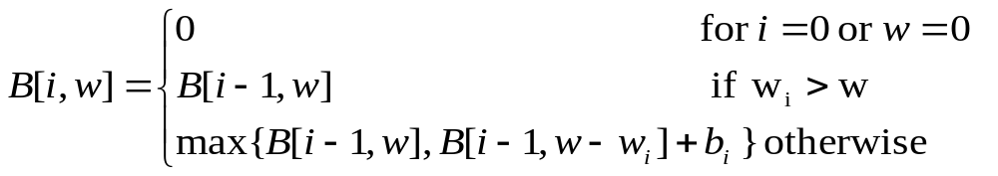
Step 2. Recursive solution
3 cases:
1. There are no items in the knapsack, or the weight of the knapsack is 0 - the benefit is 0
2. The weight of item_{i} exceeds the weight w of the knapsack - item_{i} cannot be included in the knapsack and the maximum benefit is B[i-1, w]
3. Otherwise, the benefit is the maximum achieved by either not including item_{i} ( i.e., B[i-1, w]),
or by including item_{i} (i.e., B[i-1, w-w_{i}]+b_{i})

Slide 36
Pseudo-code:0/1 Knapsack
(n+1)*(W+1) Matrix
Input: {w₁ ,w₂, . . . w_{n} }, W , {b₁ ,b₂, . . . b_{n} }
Output: B[n, W],
for w ← 0 to W do // row 0
B[0,w] ← 0
for k ← 1 to n do // rows 1 to n
B[k, 0] ← 0 // element in column 0
for w ← 1 to W do // elements in columns 1 to W
if (w_{k} ≤ w) and (B[k-1, w- w_{k} ] + b_{k} > B[k-1, w])
then B[k, w] ← B[k-1, w- w_{k} ] + b_{k}
else B[k, w] ← B[k-1, w]

Slide 37
Example:
W = 30, S = { ( i₁ , 5, $50 ), (i₂ ,10, $60 ), ( i₃, 20, $140 ) }

Slide 38
Example continued
W = 30, S = { ( i₁ , 5, $50 ), (i₂ ,10, $60 ), ( i₃, 20, $140 ) }
Weight: 0 ... 4 5 … 9 10 … 14 15 ... 30
MaxProfit { } 0 ... 0 0 … 0 0 … 0 0 … 0
MaxProfit{i₁} 0 ... 0 50 … 50 50 ... 50 50 … 50
MaxProfit{i₁, i₂} 0 … 0 50 … 50 60 … 60 110 … 110
B[2,10] = max { B[1,10], B[1,10-10] + b₂ }
= 60
B[2,15] = max { B[1,15], B[1,15-10] + b₂ }
= max {50, 50+60}
= 110

Slide 39
Analysis
It is straightforward to fill in the array using the expression on the previous slide. SO What is the size of the array?
The array is the (number of items+1) ∗ (W+1).
So the algorithm will run in Θ( n W ). It appears to be linear BUT the weight is not a function of only the number of items. What if W= n ! ? Then this algorithm is worse than the brute force method. One can show algorithms for 0/1 knapsack with worst case time complexity of O(min ( 2^{n}, n W )) (N169)
No one has ever found a 0/1 knapsack algorithm whose worst case time is better than exponential AND no one has proven that such an algorithm is not possible.

Slide 40
Pseudo-code
Using (W +1) *2 matrix
Note: Calculating B[k,w] depends only on
B[k-1,w] or B[k-1, w- w_{k} ]. B[n,W] = B[0,W] or B[1, W] depending on whether n is even or odd.
Knapsack01(W, w_{1,} ... w_{n} , b₁ ...b_{n} )
B ← 0 // Initialize W by 2 matrix
for k ← 1 to n do
for w ← 1 to W do // w is not w_{i}
if (w_{k} ≤ w) and (B[mod(k,2), w- w_{k} ] + b_{k}
> B[mod(k,2), w ]) then
B[w,mod(k+1, 2) ] ←
B[mod(k+1,2), w- w_{k} ] + b_{k}

